Slide 1

ONE WEEK
DATA SCIENCE

Slide 2

EFFECTIVE DATA VISUALIZATION IN DATA SCIENCE

Slide 3
PROJECT OVERVIEW

Slide 4


PROJECT OVERVIEW
We will analyze cryptocurrency/stock prices and daily returns such Bitcoin (BTC), Ethereum (ETH), Cardano (ADA), JP Morgan, P&G, United Airlines and Apple using Matplotlib and Seaborn libraries.
Cryptocurrency is a decentralized digital currency that uses cryptography to secure transactions and do not have a centralized issuing authority (Government or banks).
We will learn how to:
Perform data visualization using Seaborn and Matplotlib libraries
Plot single line plot, pie charts and multiple subplots
Plot pairplot and countplot using Seaborn
Plot correlations and heatmaps
Plot distribution plot (distplot)
Plot Histograms and Scatterplots
https://www.rawpixel.com/search/bitcoin%20png?page=1&sort=curated

Slide 5


MATPLOTLIB Vs. SEABORN
Matplotlib is a comprehensive library for creating static, animated, and interactive visualizations in Python.
Matplotlib is the godfather of data visualization libraries!
Matplotlib works great with Pandas dataFrames. The plot method on Pandas Series and DataFrames is just a simple wrapper around plt.plot():
Link to Library: https://matplotlib.org/
Seaborn is a data visualization library that sits on top of matplotlib
Seaborn offers enhanced features compared to matplotlib, it’s Matplotlib on steroids!
Link to Seaborn: https://seaborn.pydata.org/examples/index.html

Slide 6
DATA VISUALIZATION 101

Slide 7
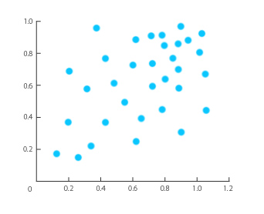
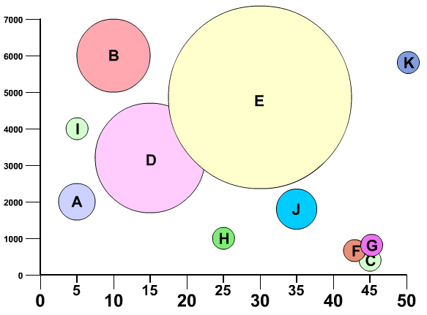
RELATIONSHIPS
SCATTERPLOT
BUBBLE CHART
“Scatterplot demonstrates the relationship between two variables (X, Y)”
“Bubble chart demonstrates the relationship between three variables (X, Y, Bubble Size)
Photo Credit: https://commons.wikimedia.org/wiki/File:Example_of_Scatter_Plot.jpg
Photo Credit: https://commons.wikimedia.org/wiki/File:Bubble_chart.jpg

Slide 8
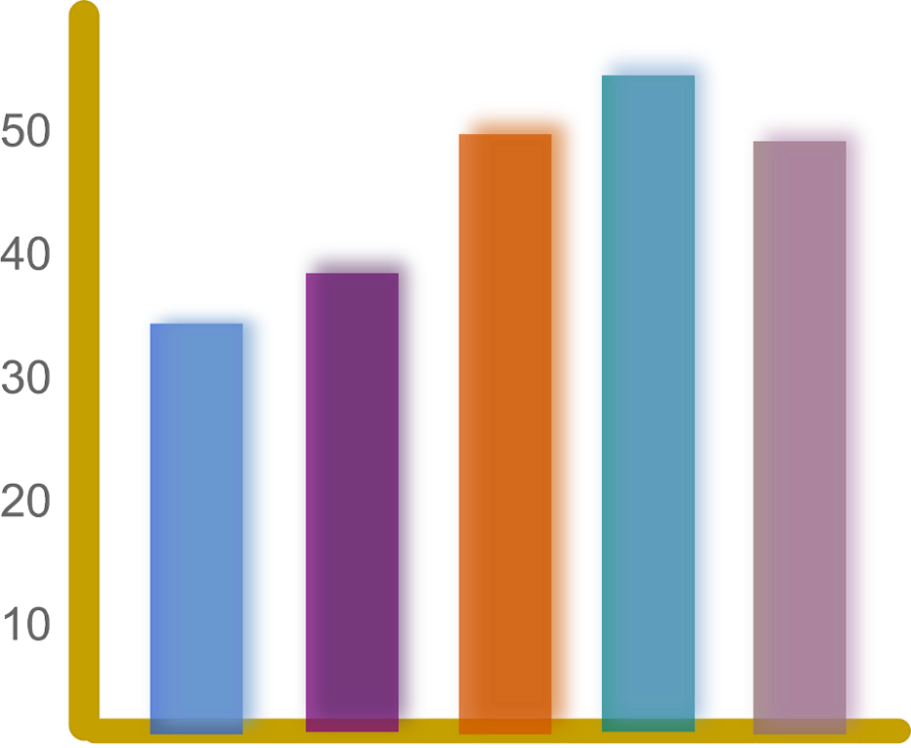
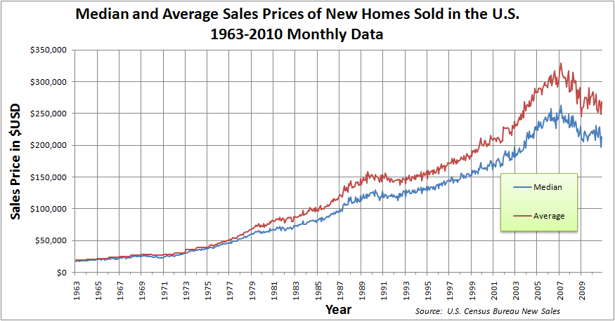
COMPARISONS
BAR CHART
LINE CHART
“Comparing median and average House prices over the years”
“Comparing salaries”
Employee #1
Employee #2
Employee #3
Employee #4
Employee #5
https://www.needpix.com/photo/89660/productivity-statistics-bar-chart-chart-graph-diagram-results
https://commons.wikimedia.org/wiki/File:Median_and_Average_Sales_Prices_of_New_Homes_Sold_in_the_US_1963-2010_Monthly.png

Slide 9
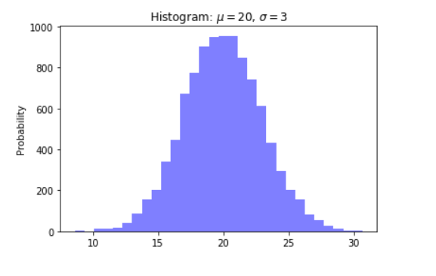
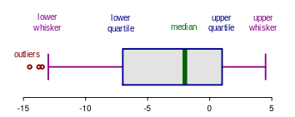
DISTRIBUTIONS
HISTOGRAMS
BOX PLOT
Photo Credit: https://commons.wikimedia.org/wiki/File:Elements_of_a_boxplot_en.svg

Slide 10
BOX PLOT
Recall: Median is the middle number in a sorted list of numbers. It is the point above and below which 50% the data falls.
MAJORITY OF THE DATA
50% PERCENTILE
MINIMUM
MEDIAN
MAXIMUM
Photo Credit: https://commons.wikimedia.org/wiki/File:Elements_of_a_boxplot_en.svg

Slide 11
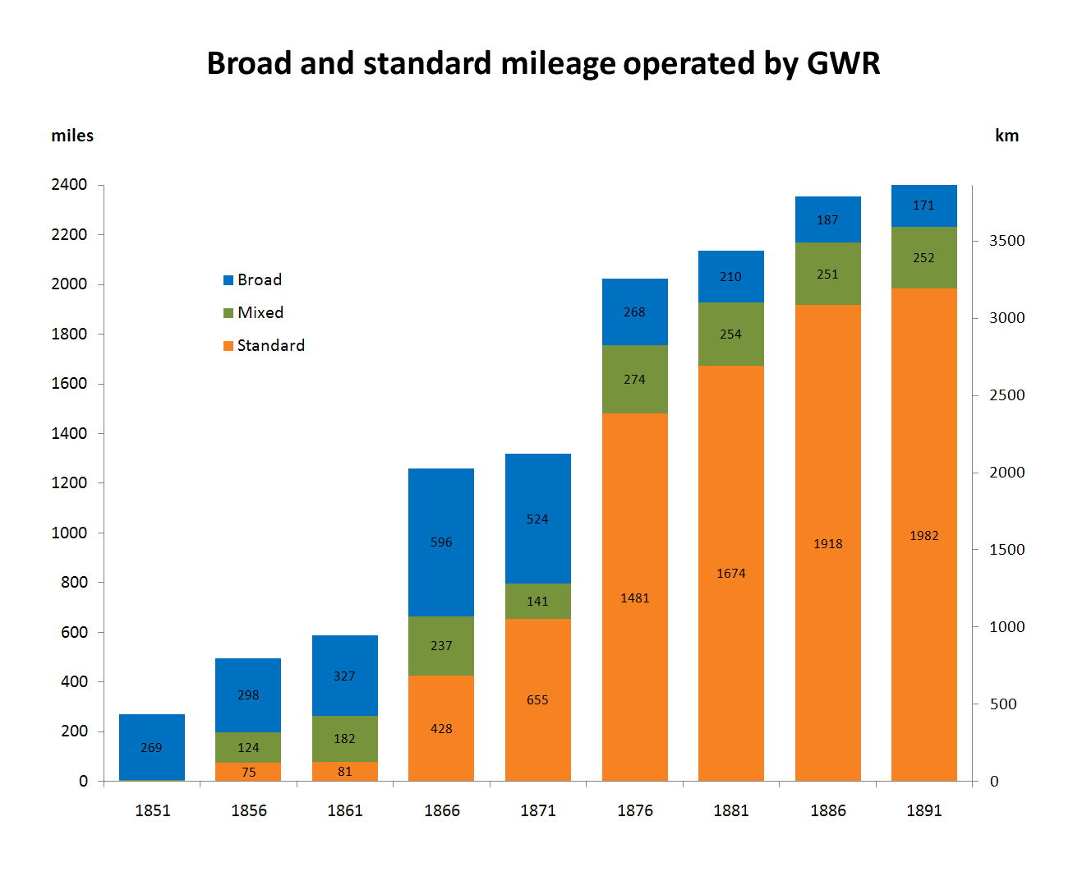
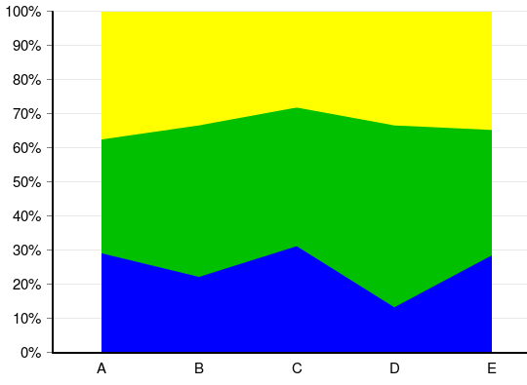
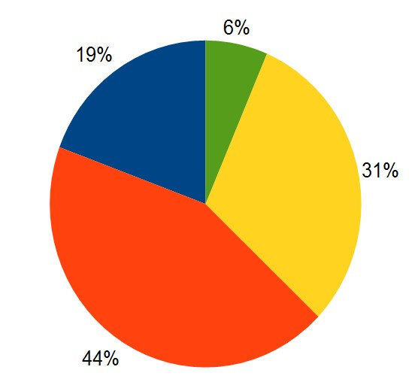
COMPOSITIONS
PIE CHART
STACKED BAR CHART
STACKED AREA CHART
Photo Credit: https://commons.wikimedia.org/wiki/File:Broad_and_standard_mileage_operated_by_GWR.png
Photo Credit: https://commons.wikimedia.org/wiki/File:Charts_SVG_Example_12_-_Stacked_100%25_Area_Chart.svg
Photo Credit: https://commons.wikimedia.org/wiki/File:Pie-chart.jpg

Slide 12
PROJECT DEMO

Slide 13
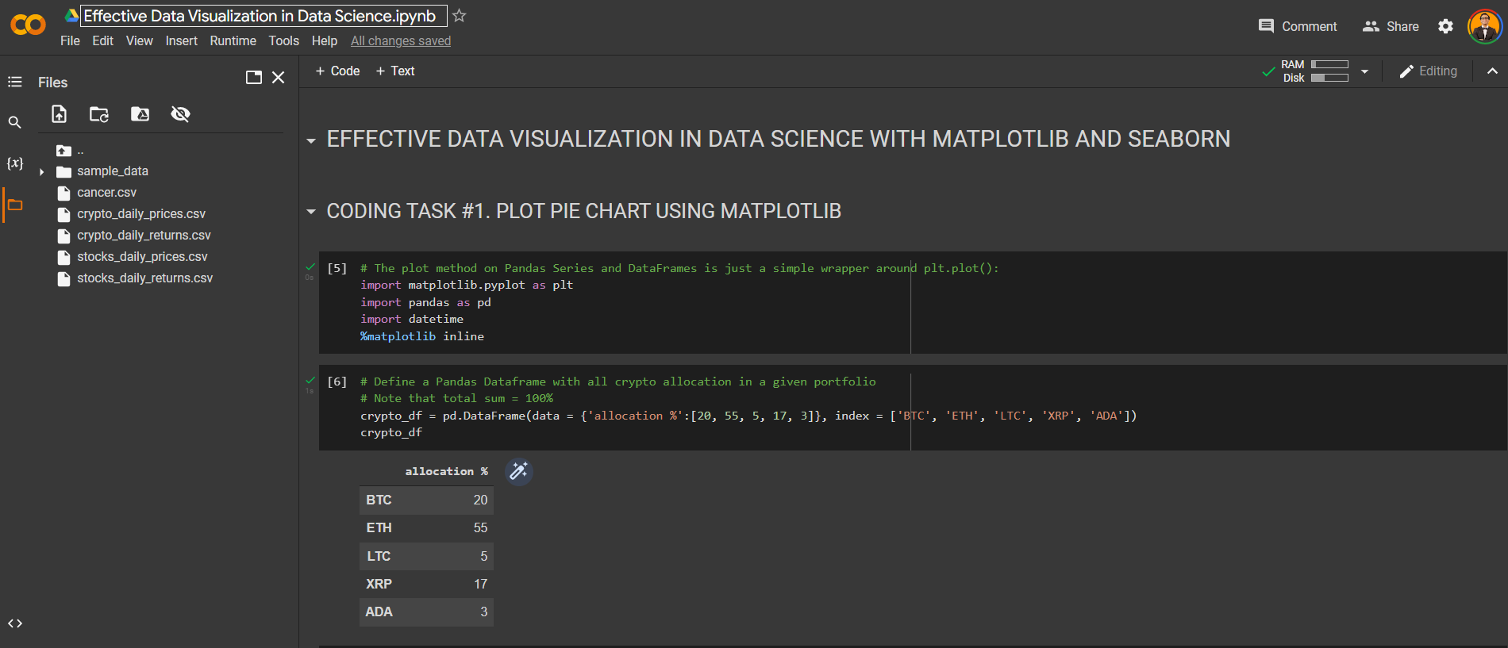
PROJECT DEMO

Slide 14
FINAL CAPSTONE PROJECT

Slide 15
CAPSTONE PROJECT TASKS
In this project, we will visualize stock prices using Seaborn and Matplotlib. 4 Stocks are considered including JP Morgan Chase (JP), Procter and Gamble (P&G) (PG), Apple (AAPL) and United Airlines (UAL).
Using the stock_daily_prices.csv and stocks_daily_returns.csv dataset included in the course/workshop package, please do the following:
Import both datasets using Pandas.
Using Matplotlib, plot lineplots that display all 4 stocks daily prices on one single figure.
Using Matplotlib, plot 4 stocks daily prices on multiple subplots.
Using Matplotlib, plot the 4 plots on subplots next to each other (all figures in one row).
Using Matplotlib, plot the scatterplot between Apple and JP Morgan daily returns.
Using Seaborn, plot similar scatterplot between Apple and JP Morgan daily returns.
Assume that you decided to become bullish on AAPL and you allocated 70% of your assets in it. You also decided to equally divide the rest of your assets in other stocks (JPM, PG, and UAL). Using Matplotlib, plot a pie chart that shows these allocations. Use 'explode’ attribute to increase the separation between AAPL and the rest of the portfolio.
Using Matplotlib, plot the histogram for United Airlines and P&G returns using 40 bins with red color. Display the mean and Standard deviation for both stocks on top of the figure.
Using Seaborn, plot a heatmap that shows the correlations between stocks daily returns.
Plot a 3D plot showing all daily returns from JPM, AAPL and UAL [External Research is required].

